Slide 1
PLASMA MEMBRANE
PLASMA MEMBRANE ENCLOSES EVERY TYPE
OF CELL,BOTH PROKARYOTIC AND EUKARYOTIC CELLS.
IT PHYSICALLY SEPERATES CYTOPLASM FROM
THE SURROUNDING ENVIRONMENT.
IT IS A ULTRATHIN,ELASTIC,LIVING,DYNAMIC
SELECTIVE TRANSPORT BARRIER.
ALL BIOLOGICAL MEMBRANES HAVE SIMILAR STRUCTURE AND SELECTIVE PERMIABILITY,BUT
DIFFER IN FUNCTION.

Slide 2
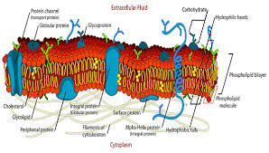
Structure of plasma membrane

Slide 3
MADE UP OF PROTEINS,LIPIDS AND CARBOHYDRATES.
LIPIDS---PHOSPHO,GLYCO,SPHINGO,STEROLS.
PROTEINS—STRUCTURAL,FUNCTIONAL,CARRIER
STRUCTURAL—EXTRINSIC,INTRINSIC
CARBOHYDRATES—GLYCOPROTEINS,GLYCOLIPIDS

Slide 4
THREE THEORIES TO EXPLAIN STRUCTURE
1.DANIELLI AND DAVESON’S BIMOLECULAR MODEL
2.ROBERTSON’S TRILAMINAR MODEL
3.HILLEIR AND HOFFMAN’S MICELLAR MODEL
4.SINGER AND NICOLSON’S FLUID MOSAIC MODEL

Slide 5
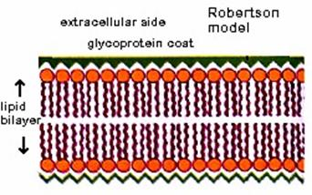

Slide 6
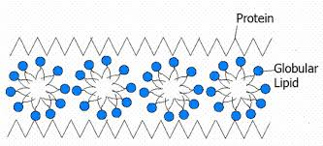
Micellar theory

Slide 7
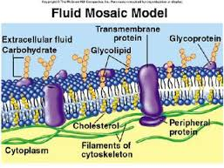

Slide 8
LIPIDS SHOW FLIP-FLOP MOVEMENT,LATERAL DIFFUSION OR ROTATION.
FUNCTIONS—1.TRANSPORT OF WATER
2.ION-TRANSPORT
3.ENDOCYTOSIS—PINOCYTOSIS AND RECEPTOR MEDIATED ENDOCYTOSIS
4.PHAGOCYTOSIS
5.SPECIAL FUNCTIONS

